Slide 1
Project 3: Classification MODEL
machine learning
Prediction of an American view toward computers algorithm based on the data collected from a Pew Research Center Survey done in 2018
Fabrice MESIDOR
Cohort ‘side-bayes - 07152019’
September 20, 2019

Slide 2
WHAT’S MY AGENDA?
INTRODUCTION
CONTEXT
THE DATA
EXPLORATORY DATA ANALYSIS
MODELING
CONCLUSION

Slide 3





JUSTIFICATION
Development of machine learning and AI
Computer decisions is running our life:
Analysts expect that people will become even more dependent on networked artificial intelligence (AI) in complex digital systems.
Raise of concern about impact of AI on production and free will
Before getting to concern → How do we perceive computer decisions? Is that perception explained by our socio-demographic profiles and habits?

Slide 4
OBJECTIVES OF THE STUDY
Academic research
Build my Data Science portfolio (blog, GitHub, codes…)
Find out:
How social and demographic behavior of an individual can help predict is view towards computer decisions?
HYPOTHESES
An adult profiles will impact his perception of computer algorithm
Social profiles (income, ethnicity,education)

Slide 5
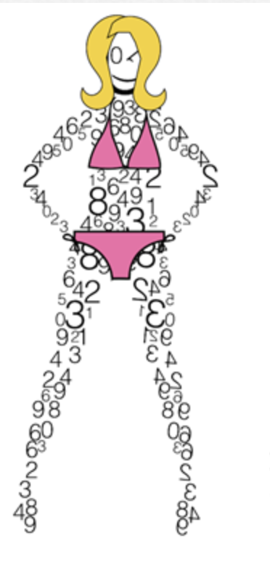

WHAT DATA?
EXPLORING DATA
MODELING
Where did it come from?
How did I treat it?
What did I keep?
How is distributed my target?
What about the features?
Are they correlated?
Different models used?
Model selected? Mode of selection
Testing and Validation?

Slide 6
THE DATA USED
Sources
Observations
Variables
Survey of US adults conducted by Pew Research Center in May-June 2018
https://www.pewinternet.org/?post_type=dataset
4,594 non-institutionalized persons age 18 and over, living in the US, including Alaska and Hawaii.
The dataset contained 190 columns – from questions
Only 33 used for my research

Slide 7
METHODOLOGY
Data downloaded as SPSS file
Python and libraries
for EDA and modeling
All models and graphs computed using Python

Slide 8
VARIABLES
View towards computer decisions
1- It is possible for computer programs to make decisions without human bias
2-Computer programs will always reflect the biases of the people who designed them

Slide 9
WHAT DATA?
EXPLORING DATA
MODELING
Where did it come from?
How did I treat it?
What did I keep?
How is distributed my target?
What about the features?
Are they correlated?
Different models used?
Model selected? Mode of selection
Testing and Validation?

Slide 10
DATA CLEANING AND TRANSFORMATION
Remove observations with missing data
Convert the answers for 'Refused’ to a neutral modality
Scale the data for better performance
Create dummies
Rename columns name

Slide 11
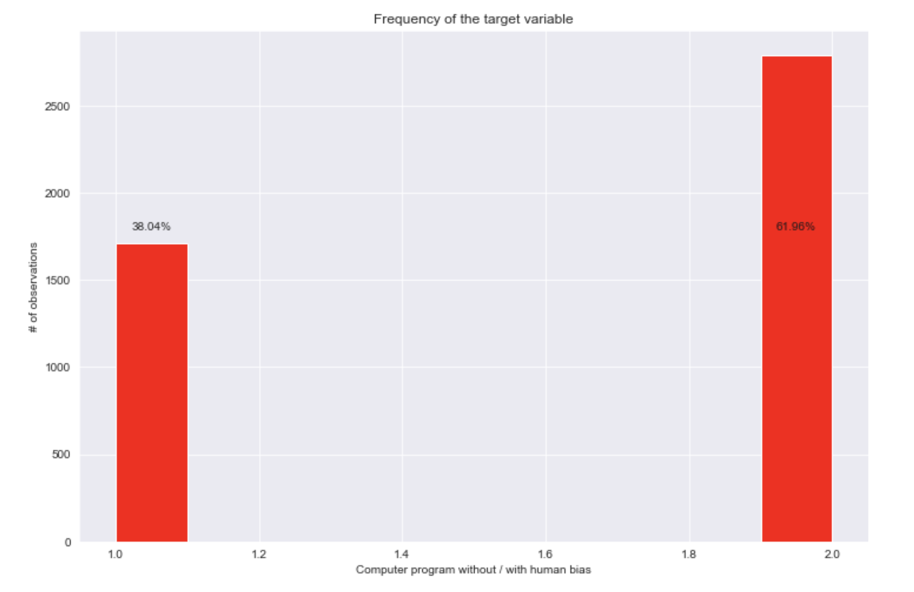
TARGET VARIABLE DISTRIBUTION
Majority of the adults interviewed think that computer algorithms are biased by designers

Slide 12
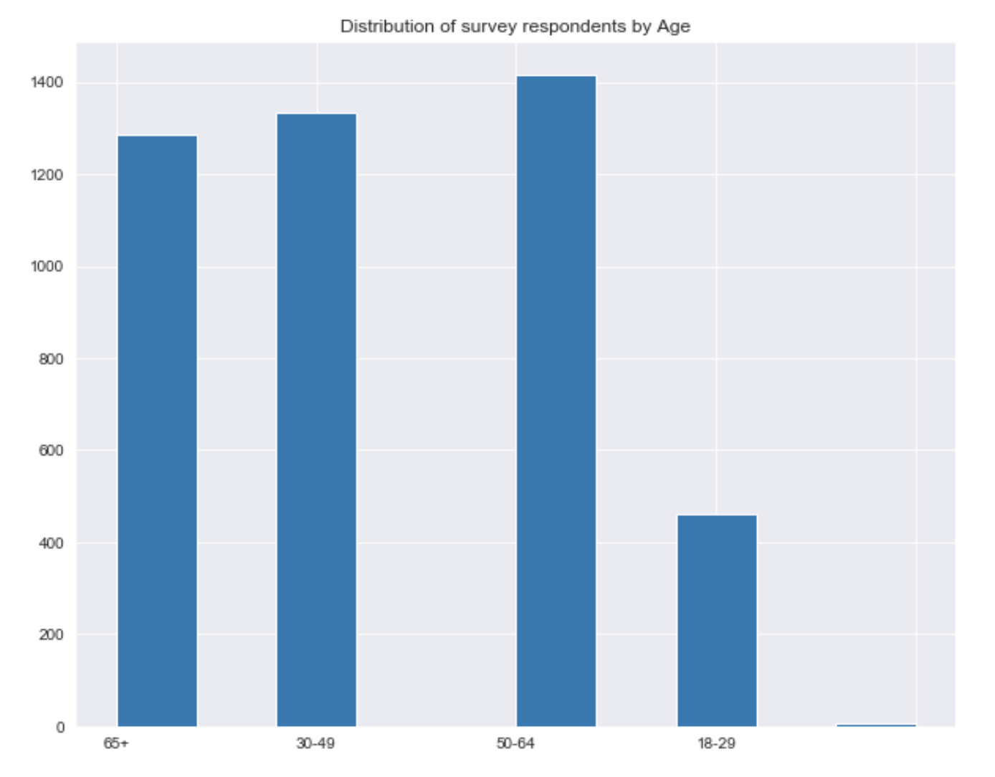
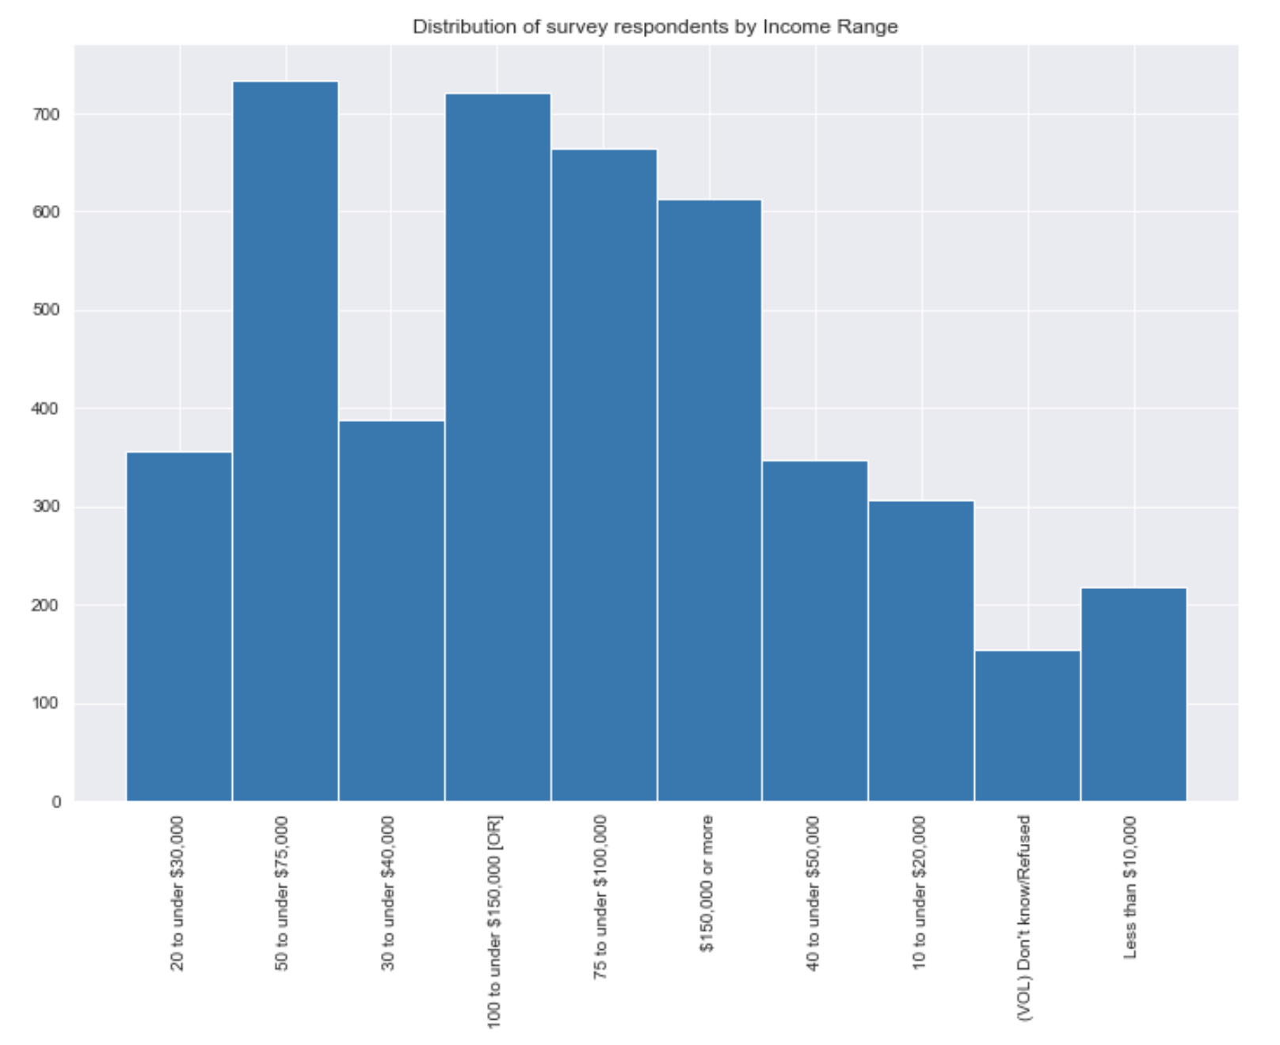
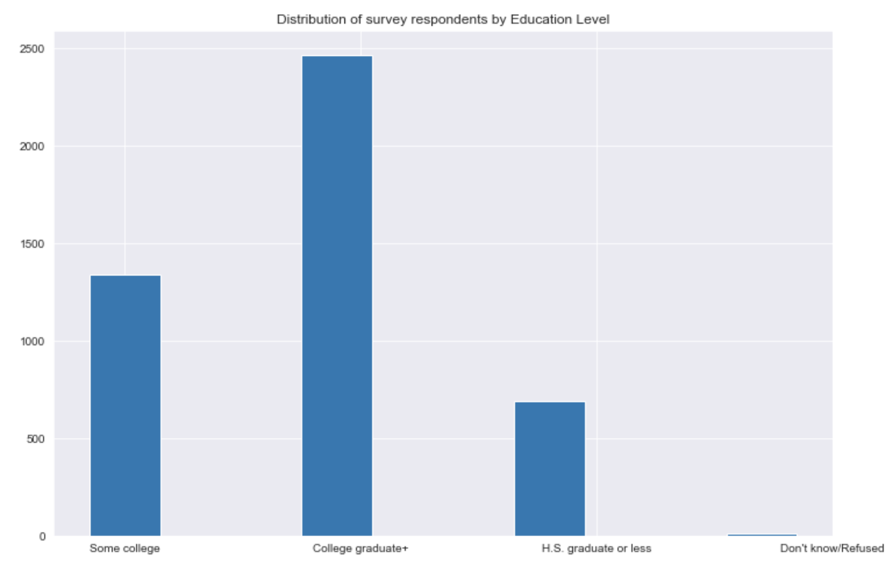
PROFILES OF RESPONDENTS
Respondents withing
earning

Slide 13
FEATURES VS. TARGET

Slide 14
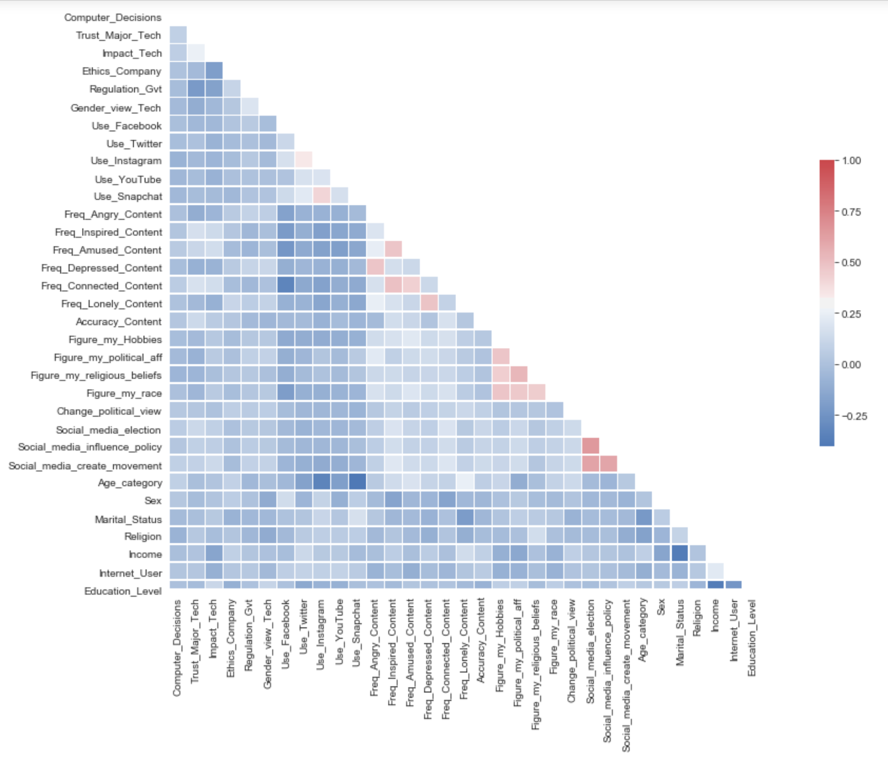
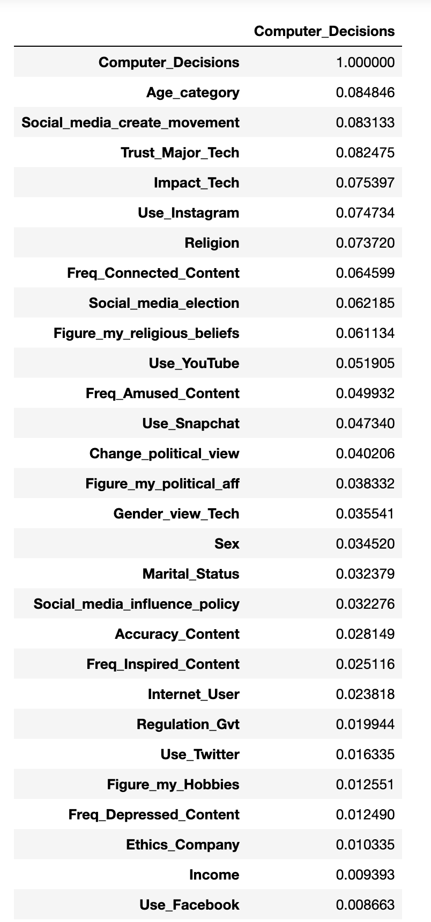
INDEPENDENCE OF FEATURES AND TARGET

Slide 15
WHAT DATA?
EXPLORING DATA
MODELING
Where did it come from?
How did I treat it?
What did I keep?
How is distributed my target?
What about the features?
Are they correlated?
Different models used?
Model selected? Mode of selection
Testing and Validation?

Slide 16
STARTED FROM THE BOTTOM…

Slide 17
DIFFERENT MODELS USED

Slide 18
REDUCTION OF FEATURES: PCA

Slide 19
RESULTS OF MODELS USING PCA

Slide 20
NOW WE HERE… FINAL MODEL

Slide 21
TESTING MY MODEL

Slide 22
CONCLUSION

Slide 23
QUESTIONS???

